Slide 1

Stopping Browser Exploits
Tarun Tanmay
Jai Verma

Slide 2
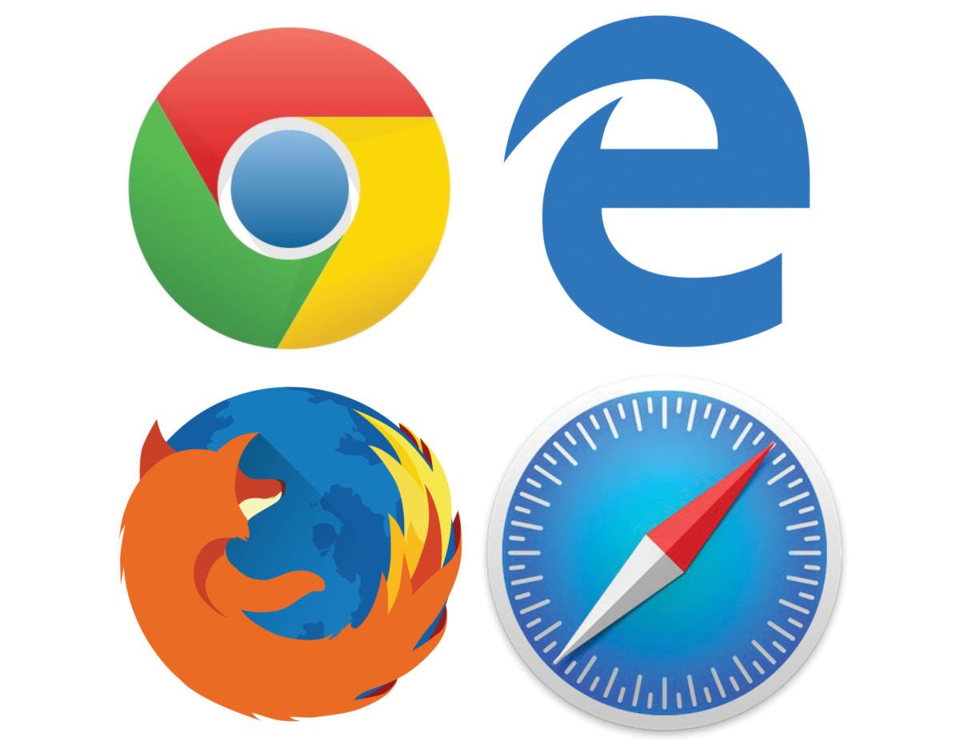
INTRODUCTION
BROWSER EXPLOITS
A malicious code that takes advantage of a vulnerability in the code of a web browser in order to breach a its security and access data or modify settings.
How Exploits Work
Exploitable Characteristics
Common Vulnerabilities
Cookies
Web Spoofing
Web Server Exploits

Slide 3
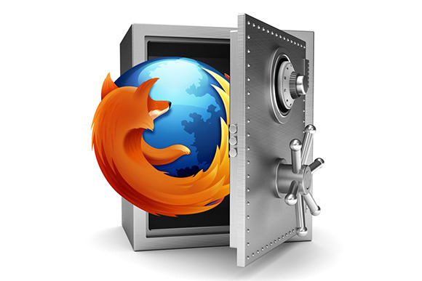
Browser Exploits
Since browsers are a computer’s gateway to the internet, they are used in almost all computers. On most days, a browser interacts with at least one infected website and possibly even exchanges data with it.
Most browsers are developed to let this interaction happen without causing any infection in the browser itself. However, there are still some vulnerabilities which go unfixed.
When a browser that contains a vulnerability meets up with a website that is infected in one of the ways mentioned above, it allows the attacker to take control of the browser.

Slide 4

How Exploits Work
Browser exploits are code that allow attackers to abuse flaws and vulnerabilities in browsers and their extensions or websites, applications, and third-party plugins like JavaScript, ActiveX, and the notorious Flash.
Attackers use these exploits to harvest user credentials, deliver ransomware, execute malware, install malicious crypto mining software, and elevate privileges.

Slide 5
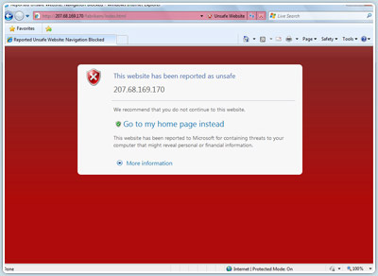
Why Do People Visit Infected Websites?
In order to infect users, attackers first need to lure their victims into performing an action that executes the malicious script. Here are some tricks attackers use to get people to visit websites where their infections are being hosted.
Email Links and Attachments
Watering Hole Attacks
Exploit Kits

Slide 6
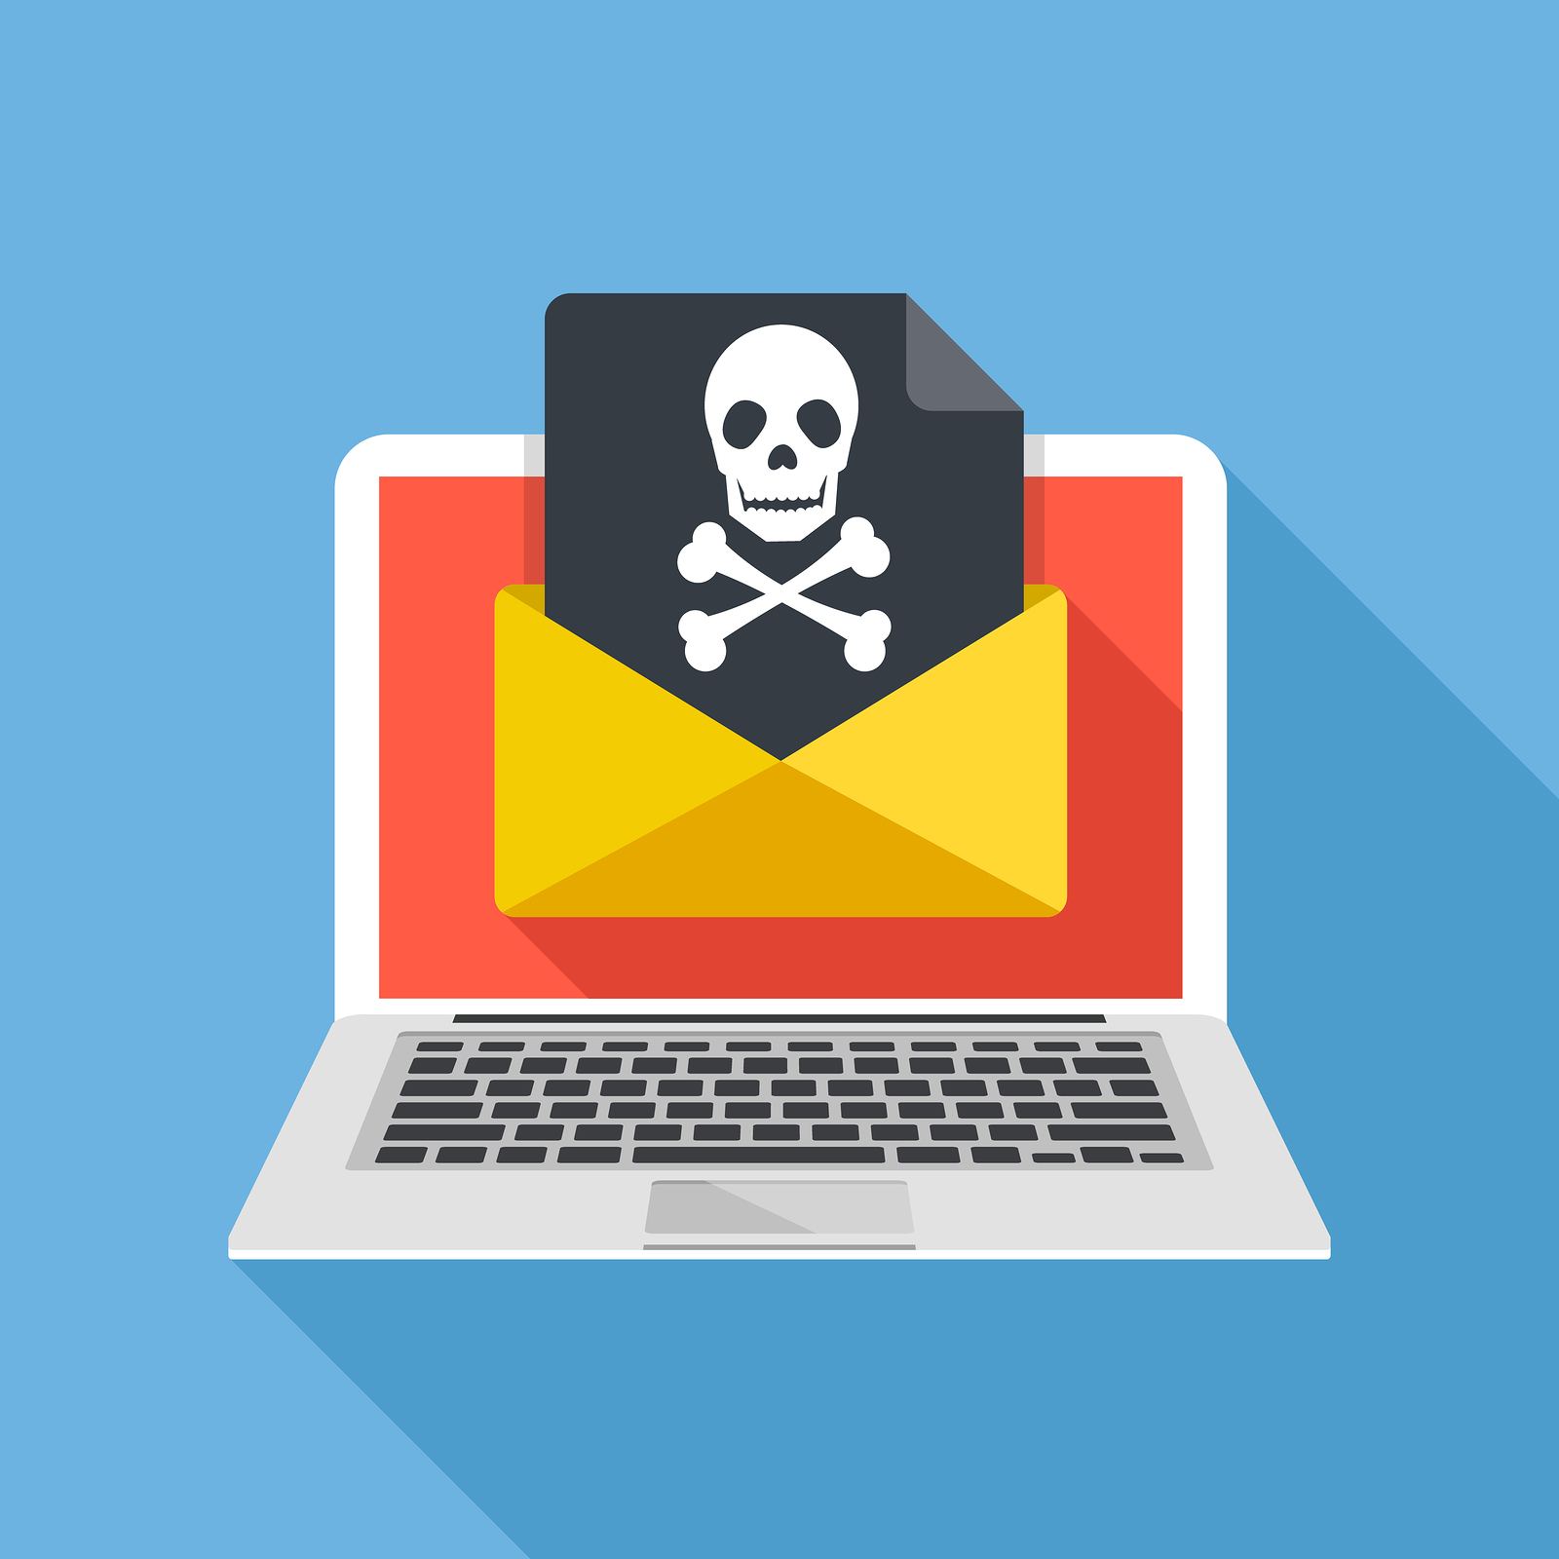
Email Links and Attachments
Attackers insert malicious content into otherwise-safe websites or create their own malicious websites. They then send out emails with links or attachments, directing recipients to the infected website. When the victim receives the email and clicks the link or opens the attachment, he or she is directed to the website where the infected payload is remotely installed onto their computer.

Slide 7

Watering Hole Attacks
Watering hole attacks attempt to compromise a specific group of users by studying their surfing habits to see what site they commonly visit. Attackers then find a vulnerability on that specific site, so when their target user visits it, he or she gets infected. This method is often used with high-value targets, such as corporate users or government employees.

Slide 8

Exploit Kits
Exploit kits are all-in-one, rapidly deployable threats. Although they are far less common than they used to be, they are still a potent attack method. Typically, the attacker finds a site to infect, waits for victims to land there, and then scans the browser, operating system, and software, looking for vulnerabilities. If it finds one, it redirects the victim to the exploit kit’s landing page and delivers the payload.

Slide 9

Exploitable Characteristics in Browsers
Early browser programs were fairly simple, but today's browsers are complex; they are capable of not only displaying text and graphics, but also playing sound files, movies, and running executable code. Support for running code (as "active content" such as Java, JavaScript, VBScript, and ActiveX) allows Web designers to create pages that interact with users in sophisticated ways. For example, users can:
Complete and submit forms across the Web
Play complex games online
Watch videos
Make Transactions

Slide 10

Why These Features Get Exploited
These characteristics of modern Web browsers serve useful purposes, but they can also be exploited in a variety of ways. Browser software stores and accesses information about the computer on which it is installed and about the user, which can be uploaded to Web servers either deliberately by the user or in response to code on a Web site.
This allows a hacker to program a website to run code in order to:
Transfer a virus to the client computer through the browser
Erase key system files
Plant a back door program that then allows the hacker to take control of the user's system

Slide 11

The King of Vulnerability: Internet Explorer
While all browsers are vulnerable to attacks; Firefox, Safari, and Chrome do have a fast response time for patching the vulnerabilities.
And then there is Internet Explorer. Internet Explorer has long been considered one of the riskiest pieces of software out there. But since it was installed by default on all computers running Windows operating systems, most consumers stuck with it, despite its flaws. In fact, until Chrome came along, many consumers didn’t even know that they had a choice in which browser they used.
IE 6 was chock-full of vulnerabilities that often took Microsoft too long to address and patch. IE 7 was an improvement, but it was still behind other browsers at the time, such as Netscape and Opera.

Slide 12
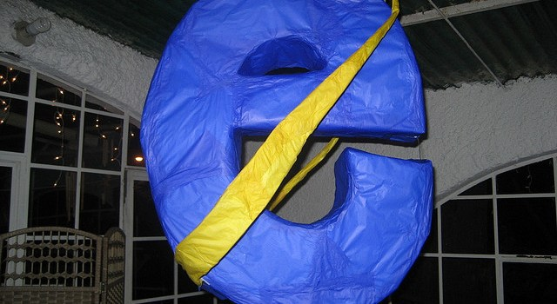
Nasty Attacks
The vulnerabilities in Internet Explorer have enabled a large portion of the malware and adware on the internet. Some of the discovered vulnerabilities affect all versions of the browser, while some only affect certain versions.
One of the worst recent Internet Explorer exploits was Double Kill (CVE-2018-8174), a remote code execution vulnerability in the Windows VBScript engine. Discovered in May 2018, it uses a “use-after-free” vulnerability with Microsoft Word as an attack vector. The Word files are sent to the user as an email attachment, which then opens Internet Explorer; this causes an executable program to open in the background, which allows Double Kill to take over the victim’s computer.

Slide 13

Common Vulnerabilities
The default configuration for most web browsers enables scripting support, which can introduce multiple vulnerabilities, such as the following:
Cross-Site Scripting
Cross-Zone and Cross-Domain Vulnerabilities
Detection Evasion

Slide 14

Cookies
Cookies are another example of a useful tool used with Web browsers that can be exploited in various ways. Cookies are very small text files that a Web server creates on your computer to hold data that's used by the site. This information could be indicators that you visited the site before, preferred settings, personal information (such as your first and last name), username, password, or anything else that the Web site's designer wanted or needed your computer to retain while you visit the site.

Slide 15
Cookie Categories
Session
Persistent

Slide 16
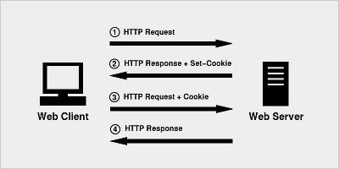
Session Cookies
Are cookies that are created to store information on a temporary basis, such as when you do online shopping and store items in a shopping cart. When you visit the Web site and perform actions (like adding items to a shopping cart) the information is saved in the cookie, but these are removed from your computer when you shut down your Web browser.

Slide 17
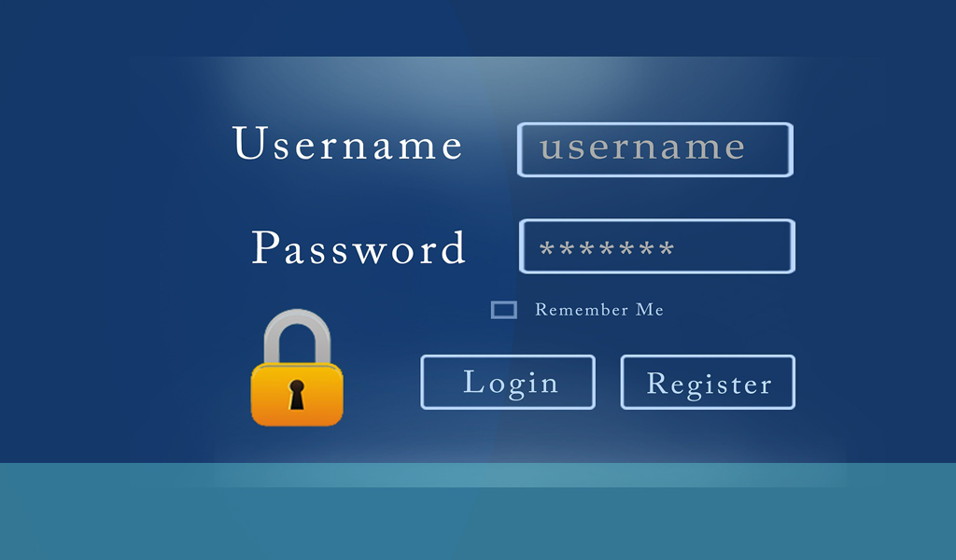
Persistent Cookies
Are cookies that are created to store information on a long-term basis. They are often used on Web sites that have an option for users to save login information, so the person doesn't have to login each time they visit, or to save other settings like the language you want content to be displayed in, your first and last name, or other information. Because they are designed to store the information long-term, they will remain on your computer for a specified time (which could be days, months, or years) or until you delete them.

Slide 18

Risk of Cookies
Since cookies are saved to computer to access the data later, the computer assumes that the data remains unchanged. However, if this data is modified, the incorrect data can be returned to the website.
Cookies can also be stolen which can allow a hacker to access a website while pretending to be you. If the cookie contained a password, the attacker will be able to access secure areas.

Slide 19

Cookie Security
If sensitive data must be stored, then the information should be encrypted and transmitted using the Transport Layer Security (TLS) or SSL protocols, which we discuss later in this tutorial. By using SSL, the cookie can be sent encrypted, meaning that the data in the cookie won't be plain to see if anyone intercepts it. Without TLS or SSL, someone using a packet sniffer or other tools to view data transmitted across the network will be unable to read the contents of the cookie.

Slide 20
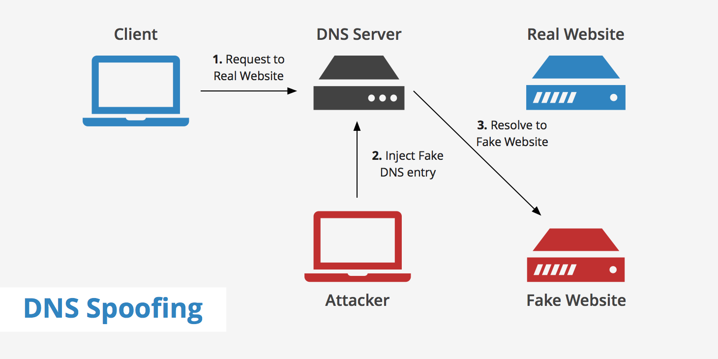
Web Spoofing
Spoofing is the act of disguising a communication from an unknown source as being from a known, trusted source. Spoofing can apply to emails, phone calls, and websites, or can be more technical, such as a computer spoofing an IP address, Address Resolution Protocol (ARP), or Domain Name System (DNS) server.

Slide 21
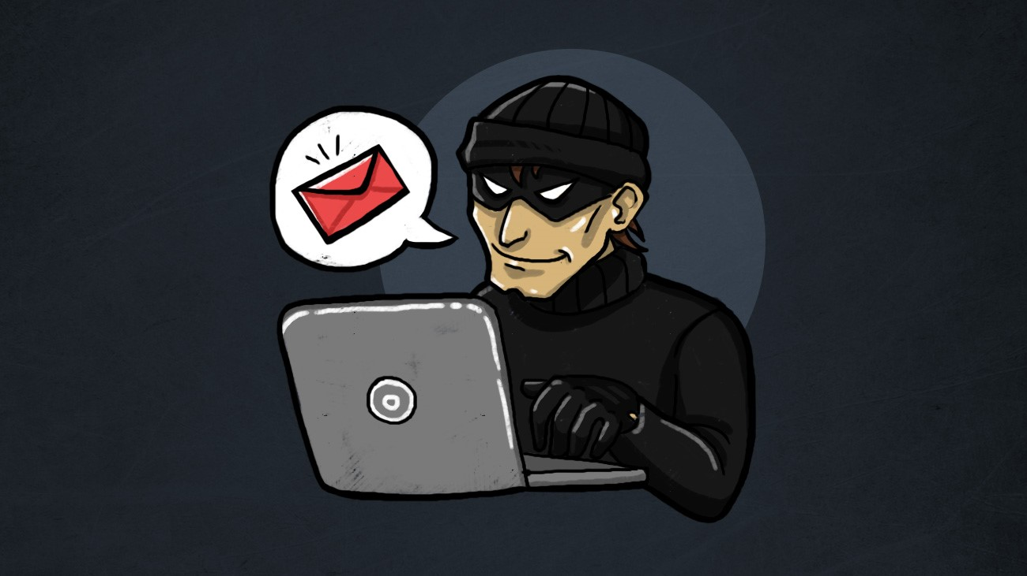
Dangers of Spoofing
Spoofing is a very dangerous exploit. This is because:
Spoofing can be used to gain access to a target’s personal information, spread malware through infected links or attachments, bypass network access controls, or redistribute traffic to conduct a denial-of-service attack. Spoofing is often the way a bad actor gains access in order to execute a larger cyber attack such as an advanced persistent threat or a man-in-the-middle attack.
Successful attacks on organizations can lead to infected computer systems and networks, data breaches, and/or loss of revenue—all liable to affect the organization’s public reputation. In addition, spoofing that leads to the rerouting of internet traffic can overwhelm networks or lead customers/clients to malicious sites aimed at stealing information or distributing malware.

Slide 22

Protection from Spoofing
When examining a communication for its legitimacy, you need to watch out for the following signs or tells:
Poor spelling
Incorrect/inconsistent grammar
Unusual sentence structure or turns of phrase
The email sender address: sometimes addresses will be spoofed by changing one or two letters in either the local-part (before the @ symbol) or domain name.
The URL of a webpage: similar to email addresses, the spelling can be slightly changed to trick a visitor not looking closely.

Slide 23
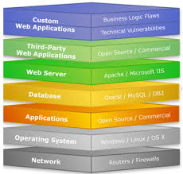
Web Server Exploits (WSE)
Transmission between web server (Internet) and web browser software (Clients) is vulnerable to network attackers
Web server applications contains bugs which can be exploited
Buffer overflows are created to take control over the web server
Arbitrary code run by attacker on Apache Web Server’s PHP
Microsoft’s IIS software exploited the code used for indexing feature
Security patches must be applied on all web servers to address the issue of WSE

Slide 24
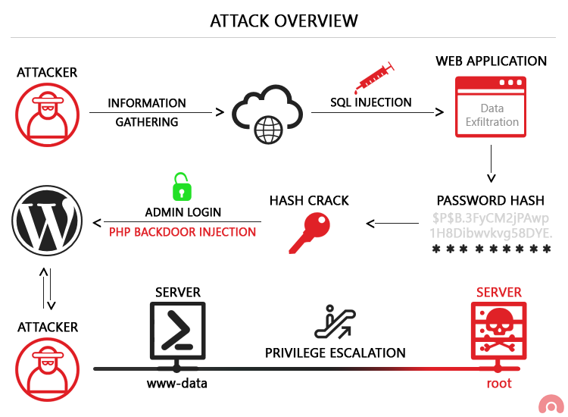
Risks of WSE
Firewall blocks the Internet traffic, though the HTTP traffic is not blocked
HTTP exploits are used to access resources which are outside the web root directory
Through Unicode directory and Double Hex encoding exploit, directory is accessed

Slide 25
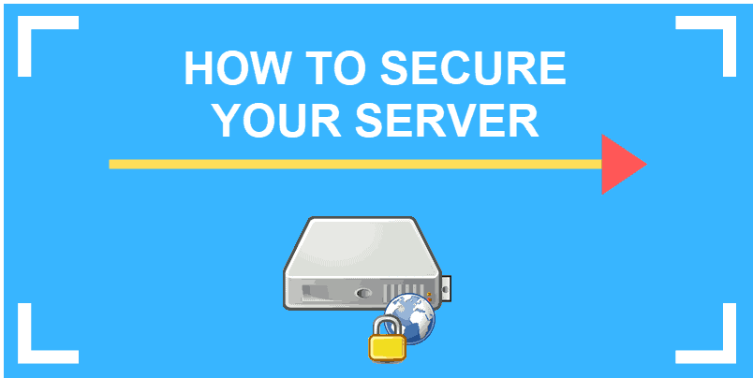
Maintaining Server Security
Using Intrusion Detection Systems
Creating Multi-Server Environment
Using SSH Keys Authentication
Using SSL Certificates on Website
Using VPN and hide server information
File and Service auditing on the server

Slide 26
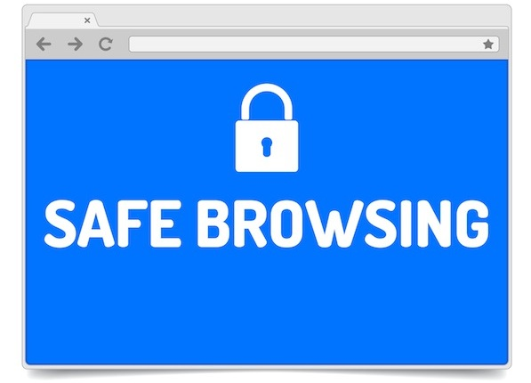
Thank You
Conclusion
The web browsers are vulnerable to different types of attacks since they lack security patches. In order to safeguard the user, pop-up blockers are linked with the web browsers. Also, OS level sandboxing and multiprocess implementation have become mandatory. In order to reduce the kernel attack surface, layout rendering and JavaScript code are put in sandboxed process.

